Slide 1
TRUE NATION ISRAELITE CONGREGATION
Passover Garments
Setting up your payment page in four steps
$175 per garment
Every man 15 and older · Paid in full by Friday, November 13
truenation.org
Notes:
Opening slide. $175 per garment, every man 15 and older, paid in full by November 13.

Slide 2
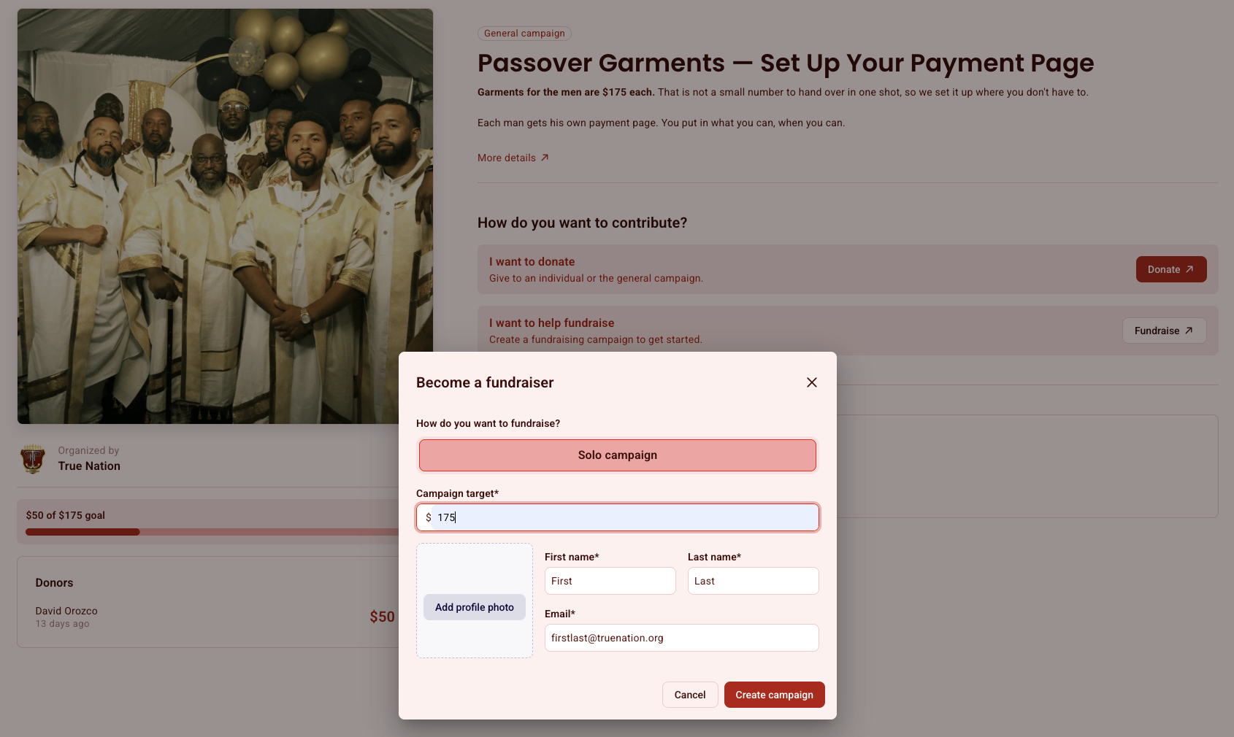
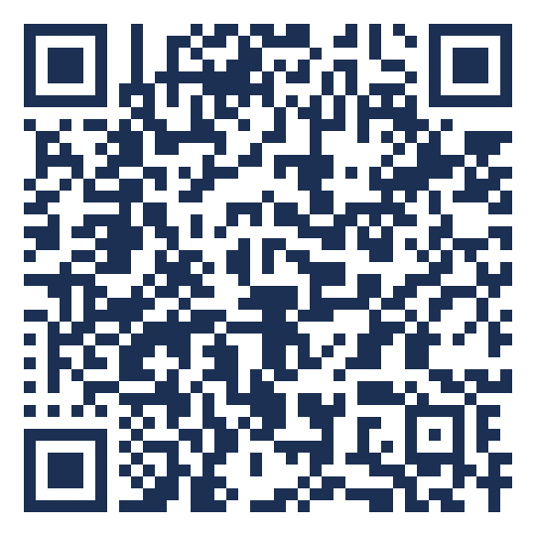
1
Open the link
The Become a fundraiser window opens on top of the campaign page.
Scan it
Same link that is in the email from Faithful Seams.
Notes:
Step 1. Opening the link pops the Become a fundraiser window automatically — nothing to click on the page itself. The QR code goes to the same campaign link that is in the email, so anyone in the room can start from their phone.

Slide 3
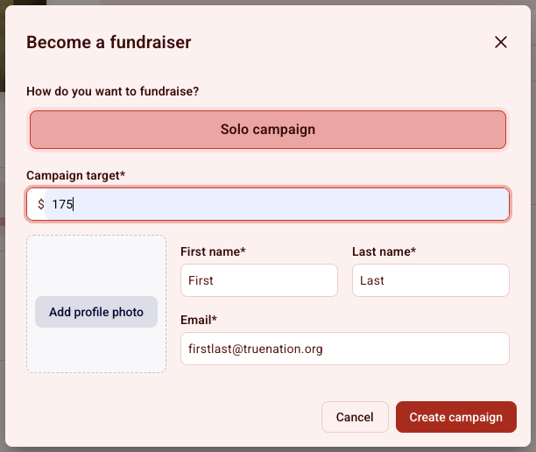
2
Fill it out, then click Create campaign
Solo campaign
Already selected. It is the only option — leave it alone.
Campaign target
$175 × how many garments you are buying. One $175, two $350, three $525, four $700.
First / last name
Yours. This is how we know whose page it is.
Email
Where your receipts go.
Profile photo
Optional. Add one if you want.
Notes:
Step 2. The campaign target is the only field men are likely to get wrong — stress the multiplication for anyone covering sons.

Slide 4
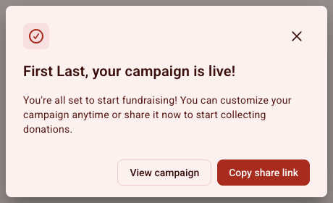
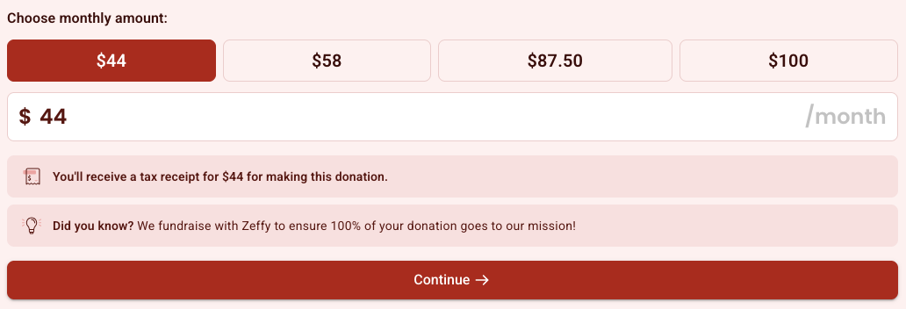
3
Bookmark the page, then make your first payment
Your campaign is live. Click View campaign and bookmark it. This is your page — open it again any time to pay or to check where you stand.
Then choose Monthly
Set up by Aug 13 — $44 a month
Set up by Sep 13 — $58 a month
Set up by Oct 13 — $87.50 a month
Zeffy charges on the same date you sign up.
Notes:
Step 3. Two things happen here — bookmarking the page, and setting the recurring amount. The bookmark matters because that page is the only way back in.

Slide 5
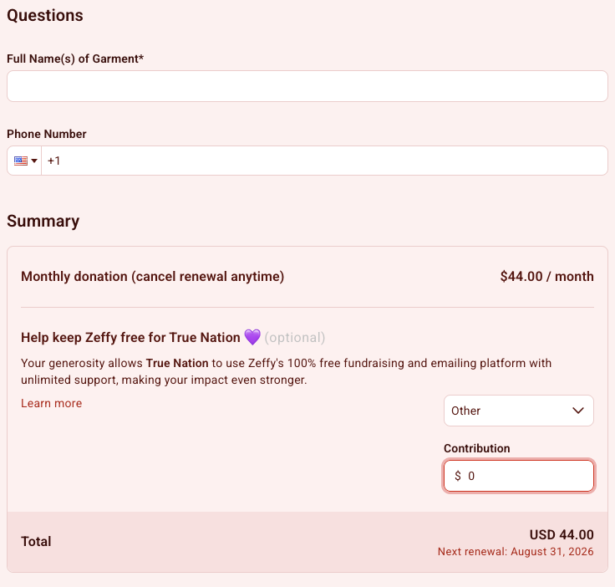
4
Answer the questions and donate
Full Name(s) of Garment Recipient(s)
Required. List everyone the garments are being made for, yourself included.
Optional contribution to Zeffy
Zeffy is free for the congregation because they ask donors for a tip. It is optional. To skip it, set the dropdown to Other and enter $0 — your total will be exactly what you meant to pay.
Monthly payments do not stop on their own.
After your final payment, cancel it from your Zeffy account or email support@truenation.org and Finance will stop it for you.
Notes:
Step 4. Two things people miss — the garment recipient names, and the Zeffy tip defaulting to a non-zero amount. Close by reminding them the recurring charge runs until someone cancels it.

